Slide 1

Welcome Year 3 and 4 Parents
Miss Armstrong (Acacia class), Mr Ashe (Cherry class) and Miss Wilson and Mrs Bale (Poplar class)
Learning Together with Kind Hearts and Determined Minds

Slide 2
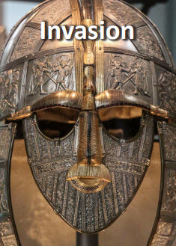
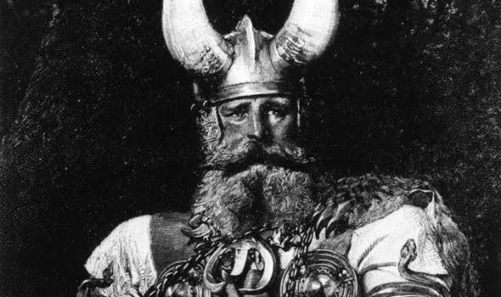
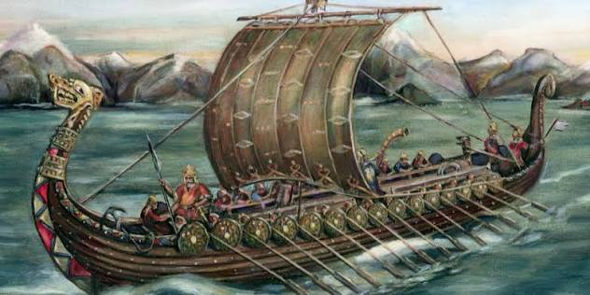
Terms 1 and 2
In terms 1 & 2, our driver subject is History and the topic is called 'Invasion'. We will be learning about the period after the Iron Age, with a focus on The Anglo-Saxons, The Vikings and a little bit about The Normans.
We will be thinking about how the Vikings were powerful warriors, every day life in these times and where key invasions took place.

Slide 3
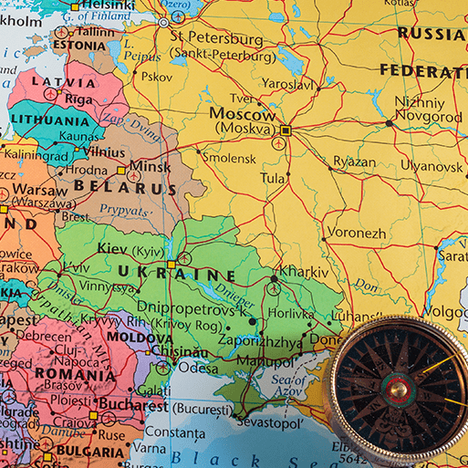
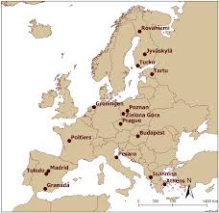
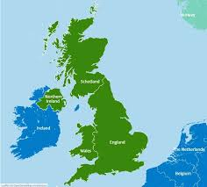
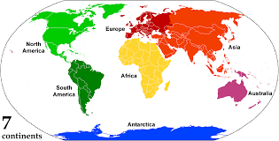
Terms 1 and 2
We will be learning how to use an atlas, including finding key places, using grid references and compass points; and about key features of Earth, such as the Equator and the tropics of Cancer and Capricorn.

Slide 4

Terms 3 and 4
In terms 3 & 4, our driver subject shifts to geography and is named 'Misty Mountain, Winding River'. We will consider the formation and journey of a river, and learn the names of famous rivers across the world. Then we will move on to learn about different types of mountains and where they are found.

Slide 5
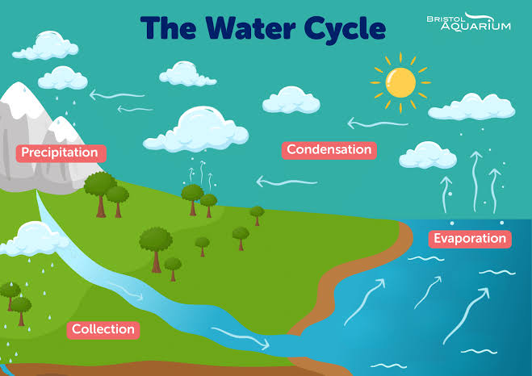
Terms 3 and 4
Also within this unit, we will learn about the water cycle and the impact this has on our environment. We will think carefully about how the world is changing, including the habitats of different wildlife.

Slide 6
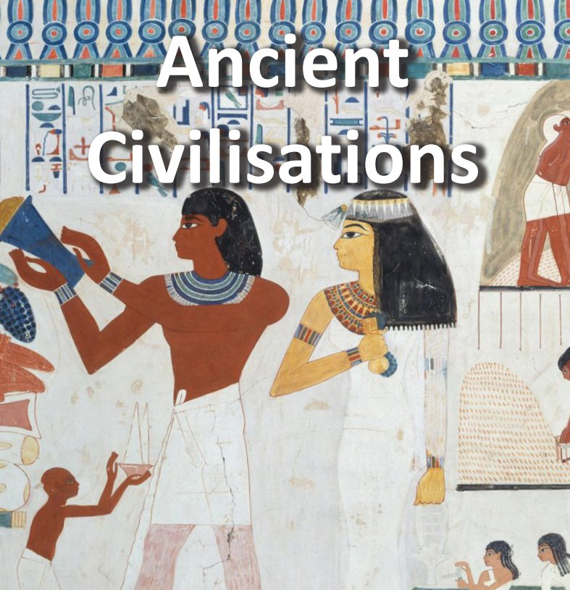
Terms 5 and 6
In terms 5 & 6, we return to a history focus with the topic ‘Ancient Civilisations'. This topic covers ancient Egypt. We will learn about every day life, the hierarchy of the people and what it was like to be a Pharaoh.

Slide 7

Science
We will aim to develop scientific knowledge and conceptual understanding through the different disciplines: biology, chemistry and physics.
In Years 3 and 4, our Science learning includes:
Term 1 & 2: food and the digestive system / sounds how we hear
Term 3 & 4: classifying solids, liquids and gases / grouping and classifying animals
Term 5 & 6: sources of electricity
Notes:
At BGPS we aim to develop scientific knowledge and conceptual understanding through the different disciplines: biology, chemistry and physics.
We want children to experience and observe phenomena and encourage children to ask questions about the world around them.
By years 5 and 6, we want children to develop a deeper understanding of a variety of scientific ideas by exploring, talking about their ideas, asking their own scientific questions and looking more systematically. Using this knowledge the children may be able to predict how the world operates, even abstract ideas.

Slide 8
Writing
Often based around a key text, sometimes linked to the topic but always rich and well-chosen
The Write Stuff – chottings, modelled writing, short sessions then an independent piece of writing at the end
Spellings and Grammar focus
Handwriting
Editing their own work and becoming more independent in doing so
Responding to marking feedback

Slide 9
Reading
Carefully selected books, sometimes linked to topics and sometimes just chosen in their own right
Whole-class reading sessions including a mixture of reading aloud, paired reading, quiet reading, whiteboard work, drama and lots of discussions
A focus on vocabulary in context
Encouragement of reading for pleasure, and being read to!

Slide 10
Maths
Split into year groups – Mr Ashe – Year 4; Miss Wilson and Mrs Bale, and Miss Armstrong – Year 3
Times table and arithmetic focus
Detailed answers to reasoning questions
Application of known facts to solve problems
White Rose Maths for sequence of lessons but other resources to supplement
Challenge and extension for those who need it
Support for those who need it – concrete, pictorial, abstract

Slide 11

Multiplication Check for Year 4
Monday 7th June – Friday 18th June
TTRS – great practice as timed and set out the same way as the check
Interventions and daily practice in school for those who need it
Regular 'mock' checks throughout the year so children are prepared

Slide 12

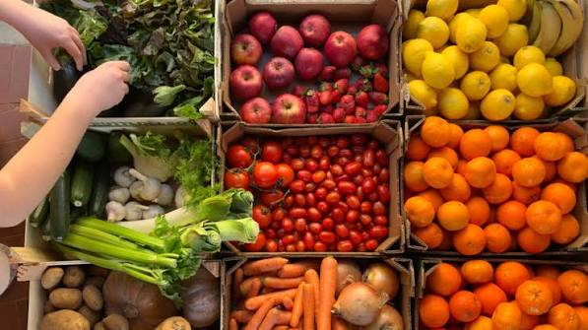
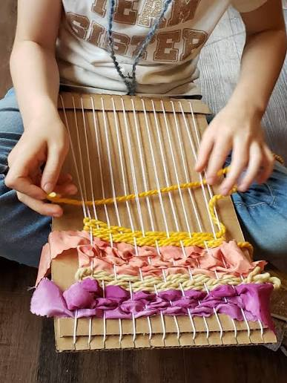
Art and DT
DT
Fresh food, Good food
Printing – William Morris
Tomb builders
Art
Weaving
Perspective
Statues and Statuettes

Slide 13
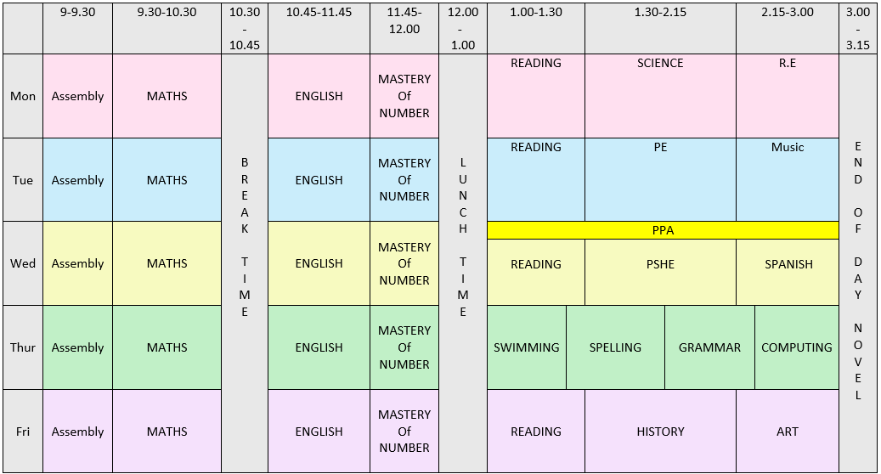
What our week looks like...
Acacia timetable
Key points:
Monday – Poplar swimming
Tuesday – Carousel
Wednesday – PPA
Thursday – Acacia swimming
Friday – Cherry swimming
Foundation subjects may change day depending on the class.
After term 1 Swimming will become a second PE session for each class.

Slide 14

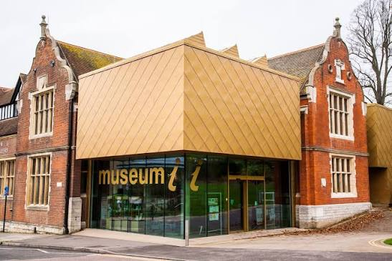
Trips and workshops
Term 5 (Friday 23rd April)
Trip to Maidstone Museum, travelling by train.
Exploring museum and artifact workshop based around ancient Egyptian artefacts.
Rou cost up to £5
Term 2 (Tuesday 3rd November)
Theatre workshop exploring Vikings and Viking gods.
Rough cost up to £10

Slide 15
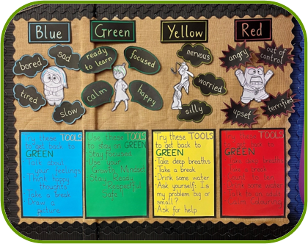
Zones of Regulation
Child first
Pupil second
Calming tools
Concentration tools

Slide 16
Behaviour & Learning Expectations
Ready Respectful Safe
Exemplary behaviour at the heart of productive learning
Calm and consistent
Self-esteem and self-discipline
Celebrate success
Restorative responsibility
Learning Together with Kind Hearts and Determined Minds
Notes:
Reuseable water bottles
Uniform

Slide 17
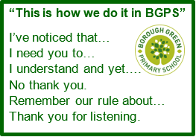
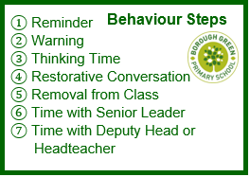

Slide 18
Learning at Home
Reading for at least 15 minutes (not all children will have reading records this year)
Quizzes on accelerated reader
Times Table Rockstars
Spelling practice – spellings emailed out
Anything linked to learning in school

Slide 19
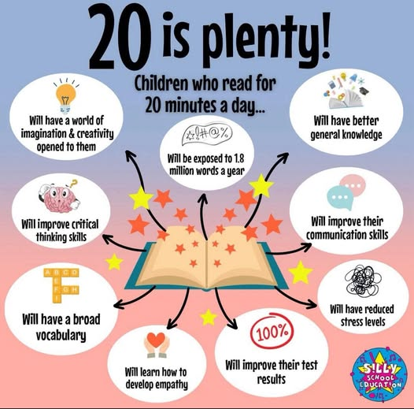

How to help your child succeed…

Slide 20
Class Assembly dates:
Poplar – Thursday 11th February
Acacia – Thursday 4th March
Cherry – Thursday 11th March

Slide 21
Questions

