Slide 1
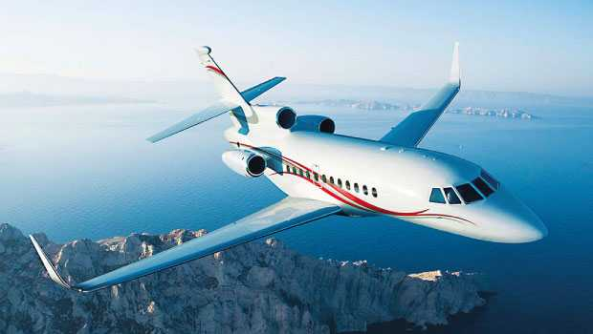
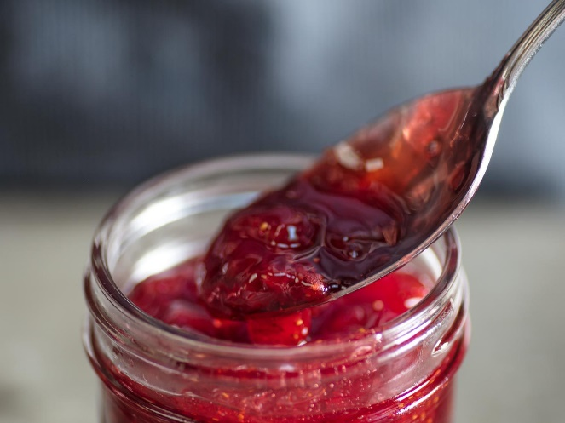
What letter is this? J
What sound does it make?
How does it look in lower case?
How does it look as a capital?
Can we read these words by blending?
jet
jam
jog
Jack
jetlag
jacket
Can you write some sentences using these words?

Slide 2

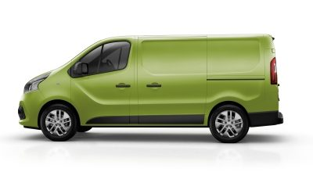
What letter is this? V
What sound does it make?
How does it look in lower case?
How does it look as a capital?
Can we read these words by blending?
van
vet
visit
Can you write some sentences using these words?

Slide 3
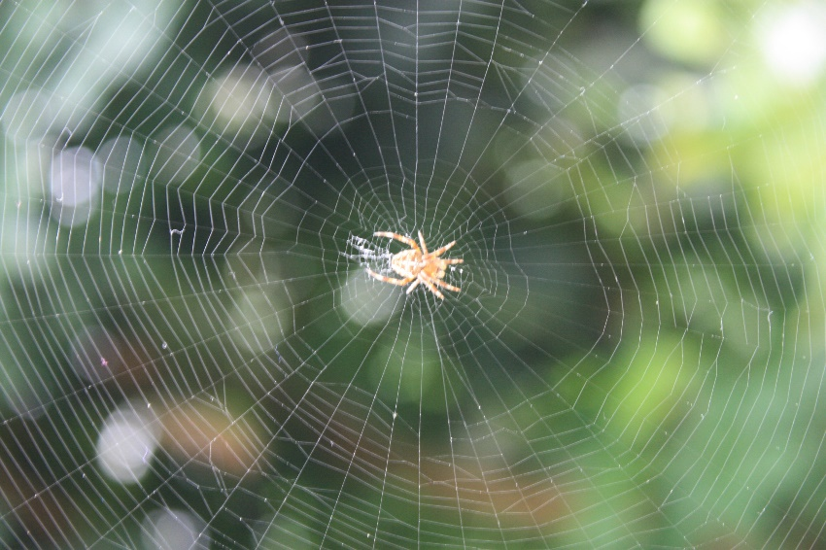

What letter is this? w
What sound does it make?
How does it look in lower case?
How does it look as a capital?
Can we read these words by blending?
will
web
win
wag
Can you write some sentences using these words?

Slide 4
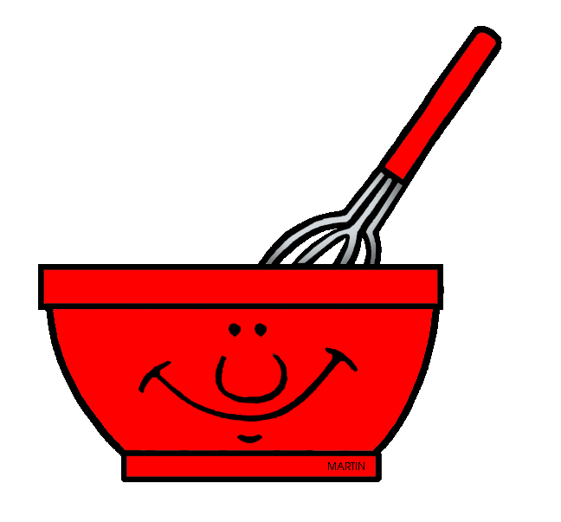
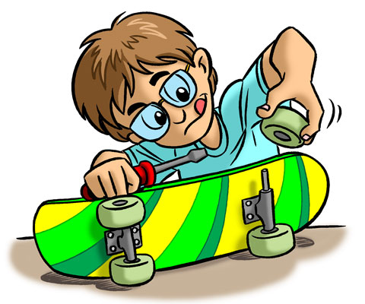
What letter is this? x
What sound does it make?
How does it look in lower case?
How does it look as a capital?
Can we read these words by blending?
mix
fix
fox
box
tax
Can you write some sentences using these words?

Slide 5

With your partner:
What letter is this? y
What sound does it make?
How does it look in lower case?
How does it look as a capital?
Can we read these words by blending?
yap
yet
yes
Can you write some sentences using these words?

Slide 6
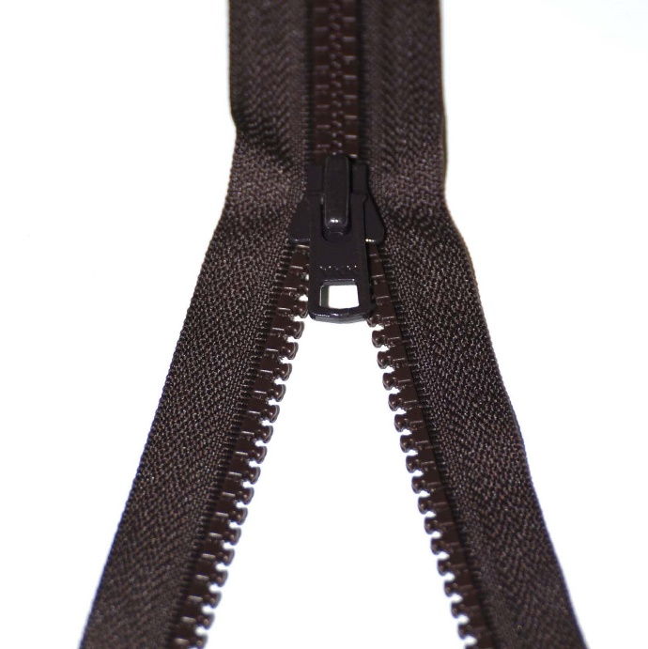
With your partner:
What letter is this? z
What sound does it make?
How does it look in lower case?
How does it look as a capital?
Can we read these words by blending?
zip
zit
zigzag
Can you write some sentences using these words?

Slide 7
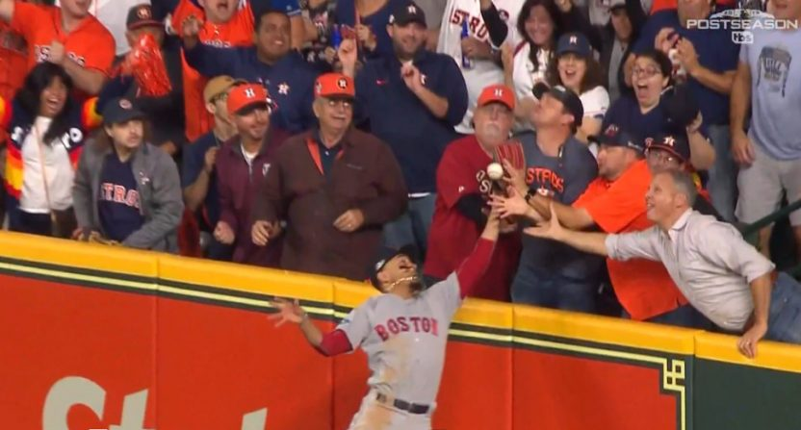
What sound does ear make?
It can also be made by ere.
Can you read these words by blending?
here
mere
severe
adhere
interfere
When you have finished, write me 3 sentences using these words.
Try to use the subordinating conjunction if.
When you have finished, practise handwriting each word.

Slide 8
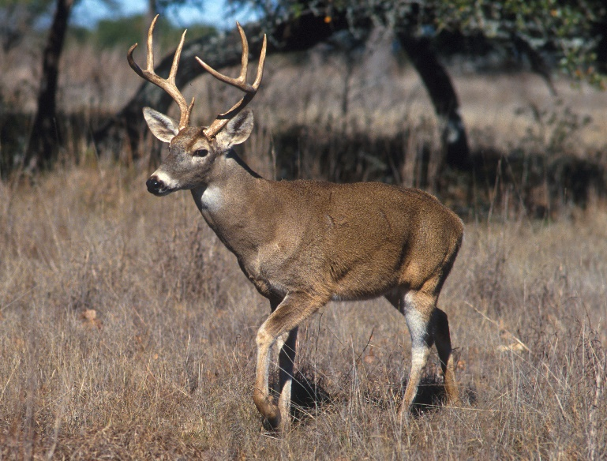
What sound does ear make?
It can also be made by eer.
Can you read these words by blending?
veer
deer
cheer
sneer
When you have finished, write me 3 sentences using these words.
Try to using the conjunction if at the beginning.
When you have finished, practise handwriting each word.

Slide 9
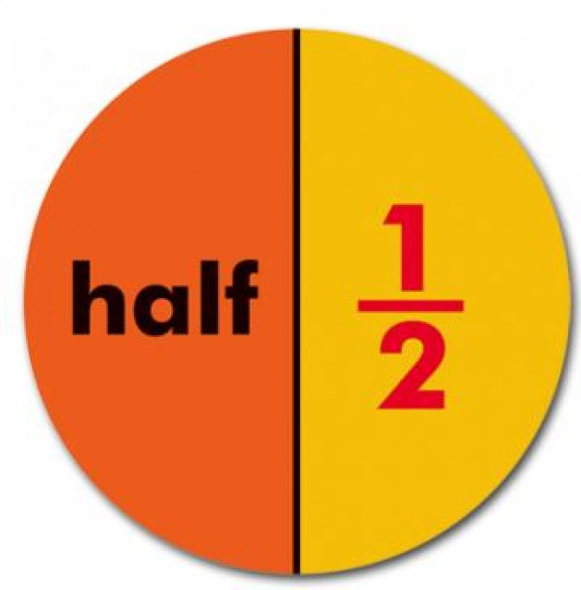
What sound does ar make?
It can also be made by al.
Can you read these words by blending?
half
calm
calf
When you have finished, write me 3 sentences using these words.
Try to using the subordinating conjunction if at the beginning.
When you have finished, practise handwriting each word.

Slide 10

What sound does ur make?
It can also be made by or.
Can you read these words by blending?
word
world
worse
work
worship
When you have finished, write me 3 sentences using these words.
Try to using the conjunction if in the middle.
When you have finished, practise handwriting each word.

Slide 11
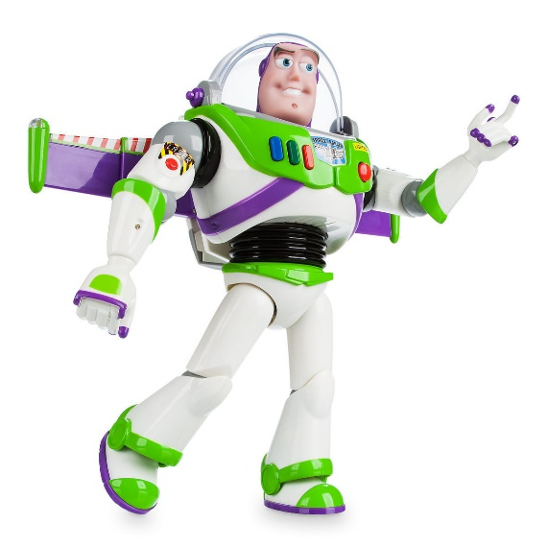
What sound is this? zz
Can we read these words by blending?
Buzz
buzz
fizz
jazz
Can you write some sentences using these words?

Slide 12
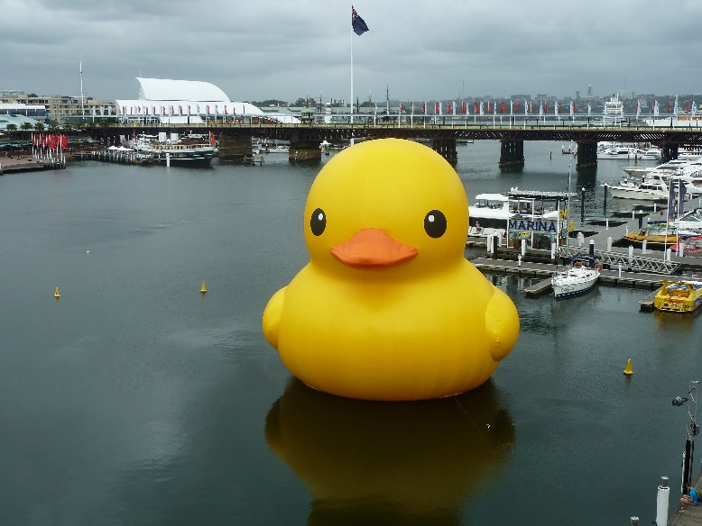
What sound is this? qu
Can we read these words by blending?
quiz
quit
quick
quack
quid
Can you write some sentences using these words?

Slide 13

What sound is this? sh
Can we read these words by blending?
shop
ship
fish
shell
shed
shock
cash
bash
rush
Can you write some sentences using these words?
Challenge yourself to use alliteration.

Slide 14
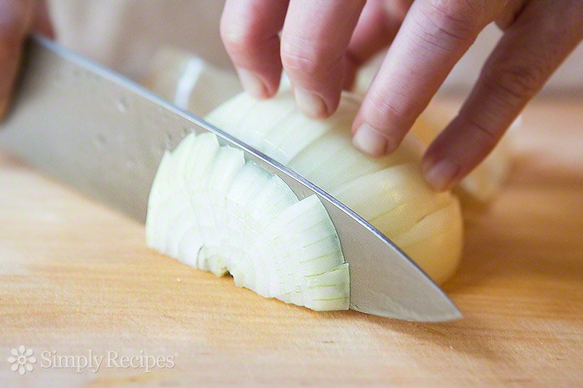
What sound is this? ch
Can we read these words by blending?
chop
chin
chuck
chill
chick
check
such
Can you read this sentence by blending?
A man is rich if he has lots of cash.
Can you write some sentences using these words?
Challenge yourself to use alliteration.

Slide 15

What sound is this? oo as in food
It can also make oo as in book
Can we read these words by blending?
look
good
book
cook
Can you add some sound buttons to these words?
wool
took
hood
When you have finished, write some of your own sentences using these words. Challenge yourself to write sentences with fronted adverbials.

