Slide 1


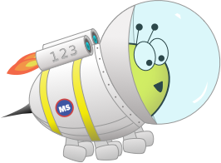

Quiz: QQVOKNB
Lesson 1: To be able to explore equivalent fractions
24th February 2021
Spring
Block 2 – Fractions
1

Slide 2


To be able to explore equivalent fractions
Starter:
Which one is the odd one out?
Explain your answer.

Slide 3
Click here for the answer: https://www.loom.com/share/2b23fc76ad78411c9ecbbcd11670fc0f
Starter:
Which one doesn’t belong?
.

Slide 4
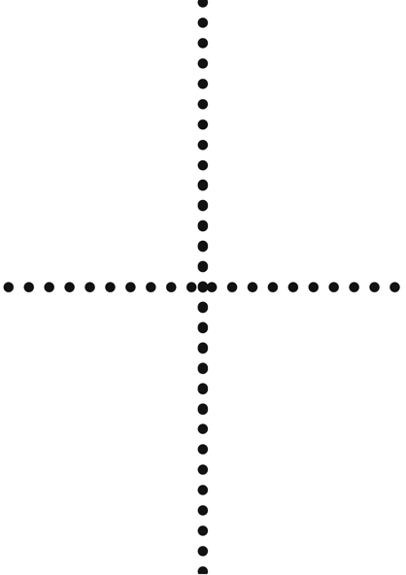



To be able to explore equivalent fractions
Talking Time:
Use a piece of paper to explore equivalent fractions.
First, fold the paper in half.
Next, fold the paper in half again.
Shade in half of the segments.
How many quarters are equivalent to 1/2?
$$\frac{1}{2}$$
=
$$\frac{2}{4}$$

Slide 5
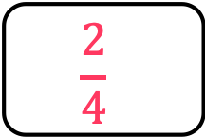
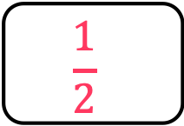
Click here for the answers: https://www.loom.com/share/e49e4c92b0f54a95b951e01b8eeeea97
Talking Time:
Use a piece of paper to explore equivalent fractions.
First, fold the paper in half.
Next, fold the paper in half again.
Shade in half of the segments.
How many quarters are equivalent to ½?
$$\frac{1}{2}$$
=
$$\frac{2}{4}$$

Slide 6
To be able to explore equivalent fractions
Talking Time:
Use a piece of paper to explore equivalent fractions.
First, fold the paper into thirds.
Next, fold the paper in half.
Now, shade in half of the segments.
How many sixths are equivalent to ½?
$$\frac{1}{2}$$
=
$$\frac{3}{6}$$
Notes:
First, fold the paper into thirds.
Next, fold the paper in half.
Shade in half of the segments.
Which fraction is half equivalent to?

Slide 7
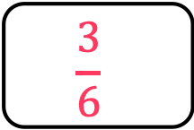
Click here to have the answers explained: https://www.loom.com/share/d3df73c7c2d34f3893c2f79488d98a0c
Talking Time:
Use a piece of paper to explore equivalent fractions.
First, fold the paper into thirds.
Next, fold the paper in half.
Now, shade in half of the segments.
How many sixths are equivalent to ½?
$$\frac{1}{2}$$
=
$$\frac{3}{6}$$

Slide 8
To be able to explore equivalent fractions
Talking Time:
Use a piece of paper to explore equivalent fractions.
First, fold the paper into thirds.
Next, fold the paper in half.
Now, shade in a third of the segments.
How many sixths are equivalent to a 1/3.
$$\frac{1}{3}$$
=
$$\frac{2}{6}$$
Notes:
First, fold the paper into thirds.
Next, fold the paper in half.
Shade in half of the segments.
Which fraction is half equivalent to?

Slide 9
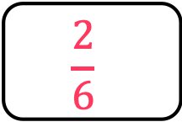
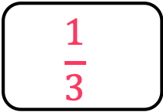
Click the link to have the answers explained: https://www.loom.com/share/e72c45275bd14fb79bb5fd2f3ee51b1a
Talking Time:
Use a piece of paper to explore equivalent fractions.
First, fold the paper into thirds.
Next, fold the paper in half.
Now, shade in a third of the segments.
How many sixths are equivalent to 1/3?
$$\frac{1}{3}$$
=
$$\frac{2}{6}$$
Notes:
First, fold the paper into thirds.
Next, fold the paper in half.
Shade in half of the segments.
Which fraction is half equivalent to?

Slide 10




To be able to explore equivalent fractions
Talking Time:
Use the models below to help you write equivalent fraction statements.
$$\frac{1}{2}$$
=
$$\frac{4}{8}$$
$$\frac{1}{4}$$
=
$$\frac{4}{16}$$

Slide 11
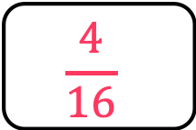
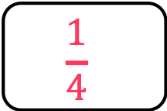
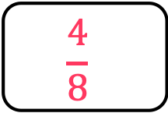
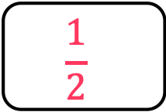
Click the link to hear the answers explained:
https://www.loom.com/share/bcfa743fa88542638e69a37afc1878a4
Talking Time:
Use the model below to help you write equivalent fraction statements.
$$\frac{1}{2}$$
=
$$\frac{4}{8}$$
$$\frac{1}{4}$$
=
$$\frac{4}{16}$$

Slide 12

To be able to explore equivalent fractions
Activity 1:
Use the model below to help you write equivalent fraction statements.
$$\frac{1}{3}$$
=
$$\frac{3}{9}$$
$$\frac{1}{4}$$
=
$$\frac{3}{12}$$
$$\frac{3}{4}$$
=
$$\frac{9}{12}$$

Slide 13
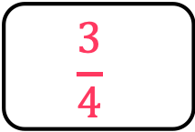
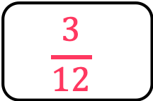
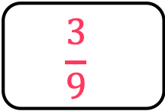
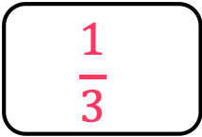
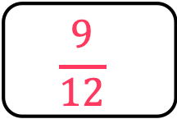
To be able to explore equivalent fractions
Activity 1:
Use the model below to help you write equivalent fraction statements.
$$\frac{1}{3}$$
=
$$\frac{3}{9}$$
$$\frac{1}{4}$$
=
$$\frac{3}{12}$$
$$\frac{3}{4}$$
=
$$\frac{9}{12}$$

Slide 14
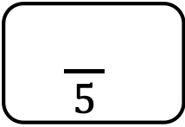
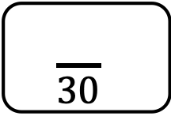
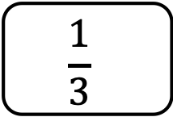
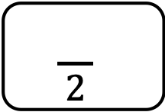
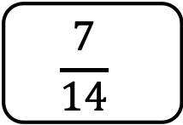
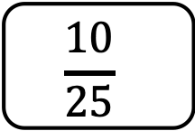
Click the link to hear me talk through the first one: https://www.loom.com/share/fdab20998a0a4f208b4c90db8e91d0c4
Talking Time:
Ruth uses area models to support her understanding of using multiplication or division to find equivalent fractions.
.
.
.
$$\frac{1}{3}$$
=
$$\frac{}{30}$$
$$\frac{}{5}$$
=
$$\frac{10}{25}$$
$$\frac{7}{14}$$
=
$$\frac{}{2}$$

Slide 15
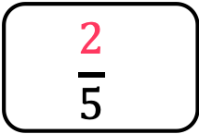
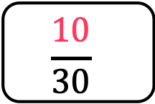
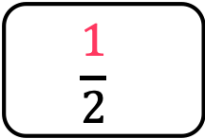
To be able to explore equivalent fractions
Talking Time:
Ruth uses area models to support her understanding of using multiplication or division to find equivalent fractions.
.
.
.
$$\frac{1}{3}$$
=
$$\frac{10}{30}$$
$$\frac{2}{5}$$
=
$$\frac{10}{25}$$
$$\frac{7}{14}$$
=
$$\frac{1}{2}$$

Slide 16
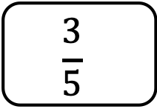
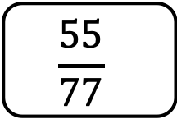
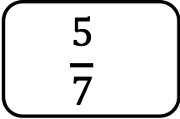
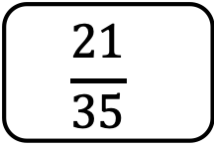
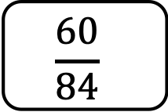
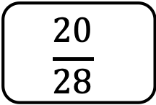
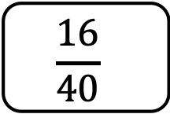
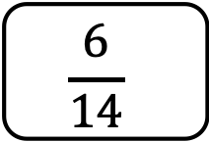
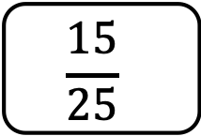
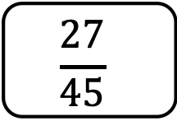
https://www.loom.com/share/279b2929f9cc498da3f61911d725bfb4
Activity 3:
We know that to find equivalent fractions, the numerator and denominator are multiplied or divided by the same number. Work out which fractions are not equivalent in each list. Watch my video to talk you through the first one.
.
.
$$\frac{15}{25}$$
$$\frac{16}{40}$$
$$\frac{3}{5}$$
$$\frac{27}{45}$$
$$\frac{21}{35}$$
$$\frac{60}{84}$$
$$\frac{5}{7}$$
$$\frac{6}{14}$$
$$\frac{20}{28}$$
$$\frac{55}{77}$$

Slide 17
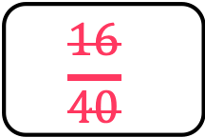
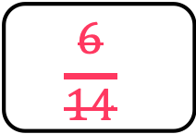
To be able to explore equivalent fractions
Activity 3:
Applying the concept that to find equivalent fraction that the numerator and denominator are multiplied or divided by the same number, eliminate fractions that are not equivalent fractions within each of the lists below.
.
.
$$\frac{15}{25}$$
$$\frac{16}{40}$$
$$\frac{3}{5}$$
$$\frac{27}{45}$$
$$\frac{21}{35}$$
$$\frac{60}{84}$$
$$\frac{5}{7}$$
$$\frac{6}{14}$$
$$\frac{20}{28}$$
$$\frac{55}{77}$$

Slide 18
To be able to explore equivalent fractions https://www.loom.com/share/04b9cc8826bc4a47906a280ab3683eb6
Activity 4:
Which of the following doesn’t belong? Click the link for a hint if you are really stuck.
Explain your answer.
A
B
C
D
A
E

Slide 19
To be able to explore equivalent fractions
Activity 4:
Which of the following doesn’t belong?
D doesn’t belong as it shows five ninths, whereas A shows two quarters, B shows four eighths, C shows three sixths and E shows six twelfths, which are all equivalent fractions to one half.
A
B
C
D
A
E

