Slide 1


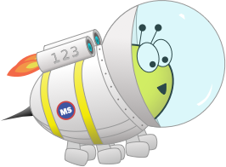

Lesson 2: To be able to convert improper fractions to mixed numbers
Spring
Block 2 – Fractions
2

Slide 2
To be able to convert improper fractions to mixed numbers
What is an improper fraction?
An improper fraction is when the numerator (the number at the top) is greater than the denominator (the number at the bottom).
What is a mixed number?
A mixed number is the combination of an integer (a whole number) and a fraction.

Slide 3


What is the same and what is different?
Talk this through with an adult or write your ideas out in full sentences. Try your best to use the correct mathematical vocabulary.
Ruth
Jamal

Slide 4
They both have quarters of pizzas. Ruth has 5 quarter. This means she has a whole pizza and 1 quarter. Jamal only has 1 quarter.
Ruth
Jamal

Slide 5

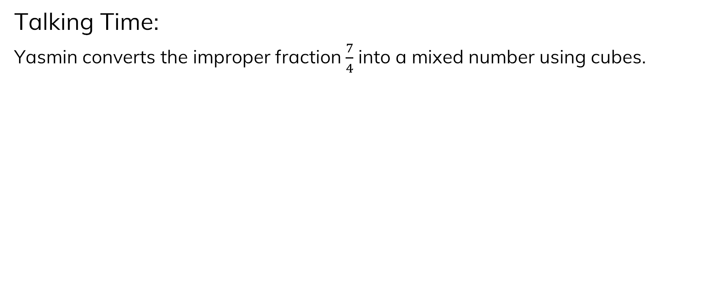
Talking Time:
Yasmin converts the improper fraction $\frac{7}{4}$ into a mixed number using cubes.

Slide 6
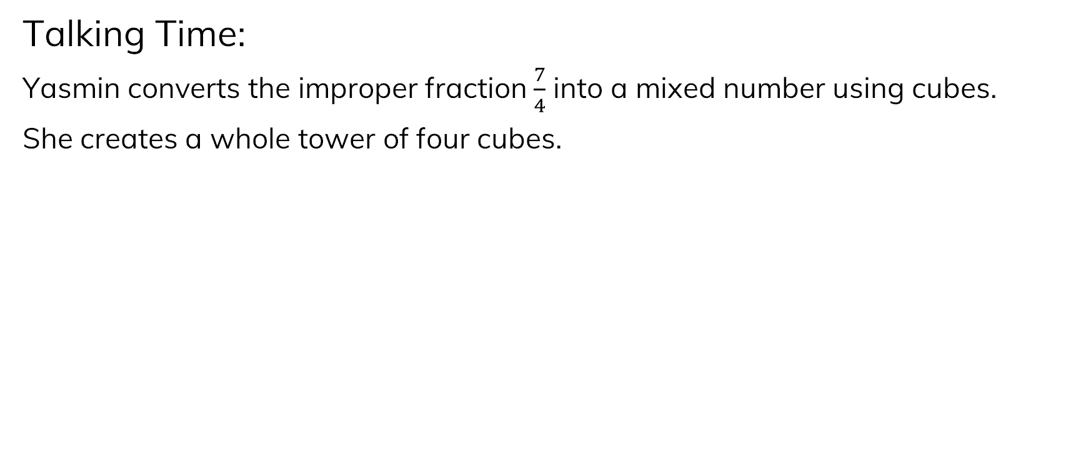
Talking Time:
Yasmin converts the improper fraction $\frac{7}{4}$ into a mixed number using cubes.
She creates a whole tower of four cubes.

Slide 7
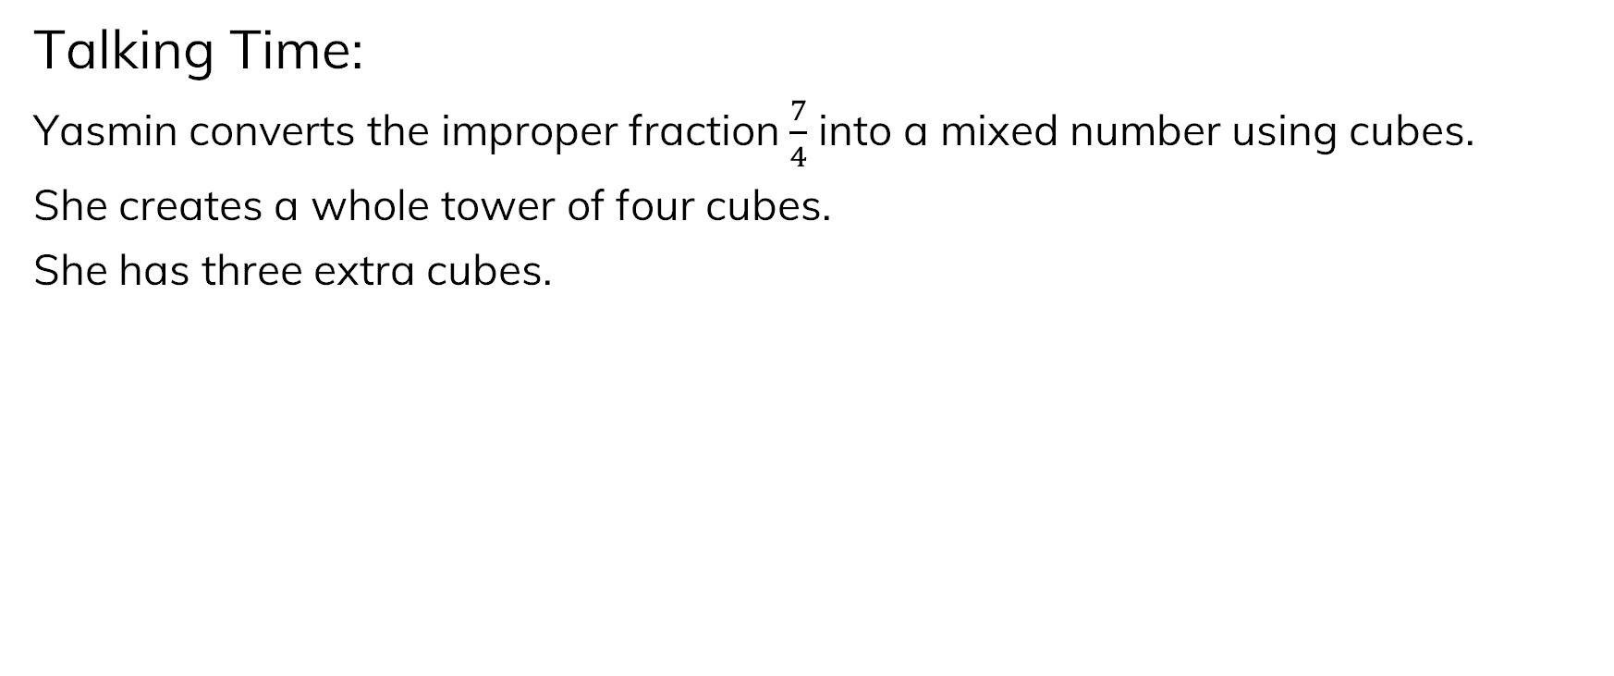
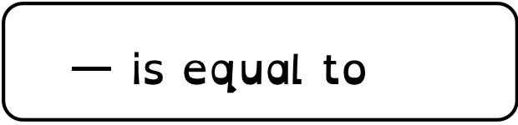
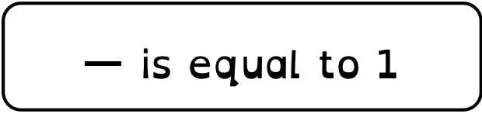
Talking Time:
Yasmin converts the improper fraction $\frac{7}{4}$ into a mixed number using cubes.
She creates a whole tower of four cubes.
She has three extra cubes.
is equal to 1
is equal to 1 $\frac{3}{4}$

Slide 8
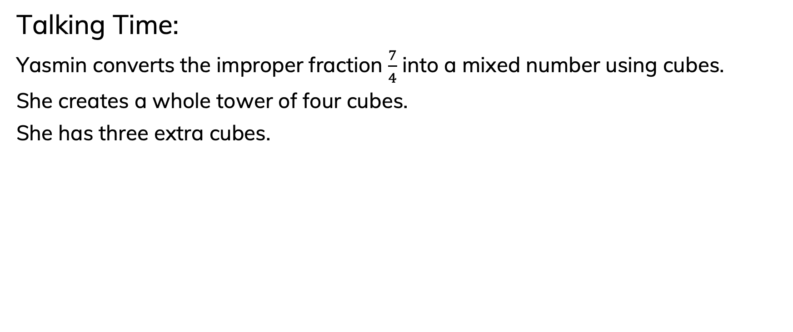
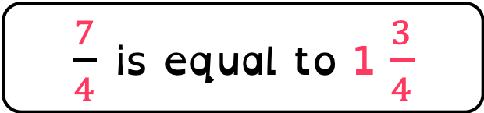
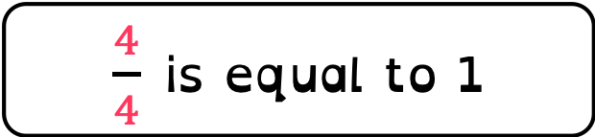
Talking Time:
Yasmin converts the improper fraction $\frac{7}{4}$ into a mixed number using cubes.
She creates a whole tower of four cubes.
She has three extra cubes.
$\frac{4}{4}$ is equal to 1
$\frac{7}{4}$ is equal to 1 $\frac{3}{4}$

Slide 9
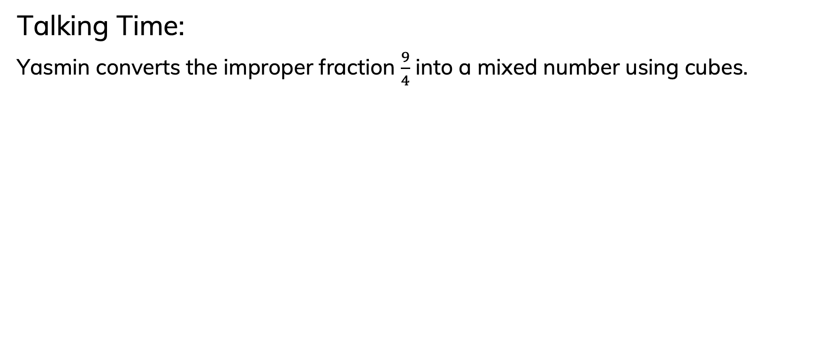
Talking Time:
Yasmin converts the improper fraction $\frac{9}{4}$ into a mixed number using cubes.

Slide 10
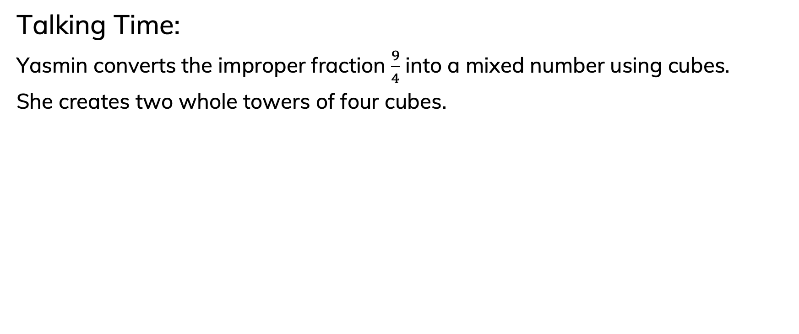
Talking Time:
Yasmin converts the improper fraction $\frac{9}{4}$ into a mixed number using cubes.
She creates two whole towers of four cubes.

Slide 11
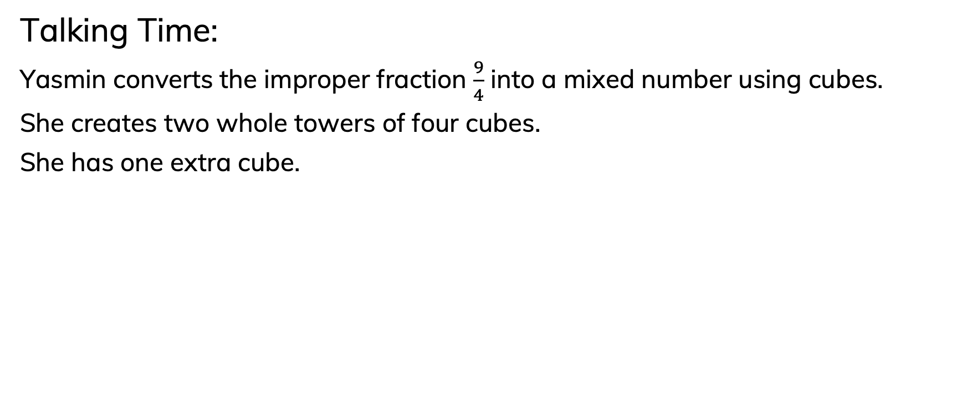

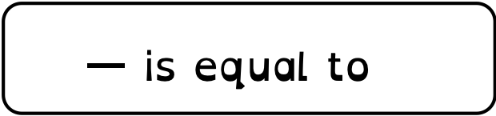
To be able to convert improper fractions to mixed numbers
Talking Time:
Yasmin converts the improper fraction $\frac{9}{4}$ into a mixed number using cubes.
She creates two whole towers of four cubes.
She has one extra cube.
is equal to 1
is equal to 2
is equal to 2 $\frac{1}{4}$

Slide 12
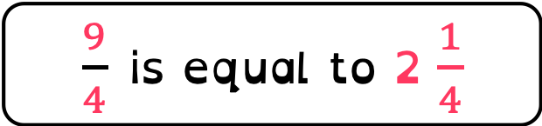
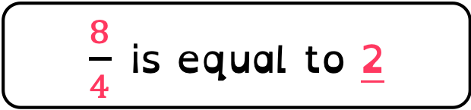
Talking Time:
Yasmin converts the improper fraction $\frac{9}{4}$ into a mixed number using cubes.
She creates two whole towers of four cubes.
She has one extra cube.
$\frac{4}{4}$ is equal to 1
$\frac{8}{4}$ is equal to 2
$\frac{9}{4}$ is equal to 2 $\frac{1}{4}$

Slide 13
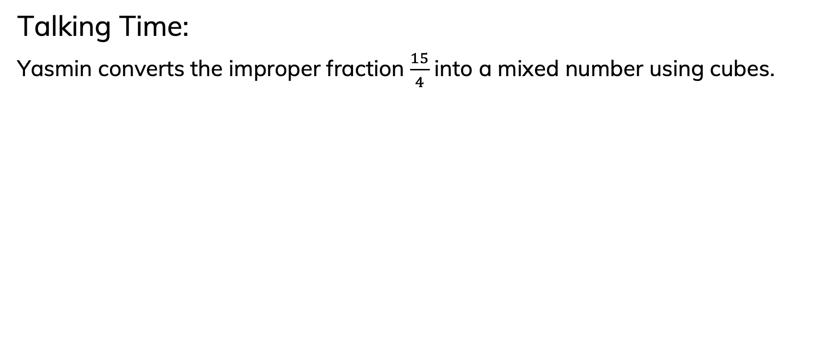
Talking Time:
Yasmin converts the improper fraction $\frac{15}{4}$ into a mixed number using cubes.

Slide 14
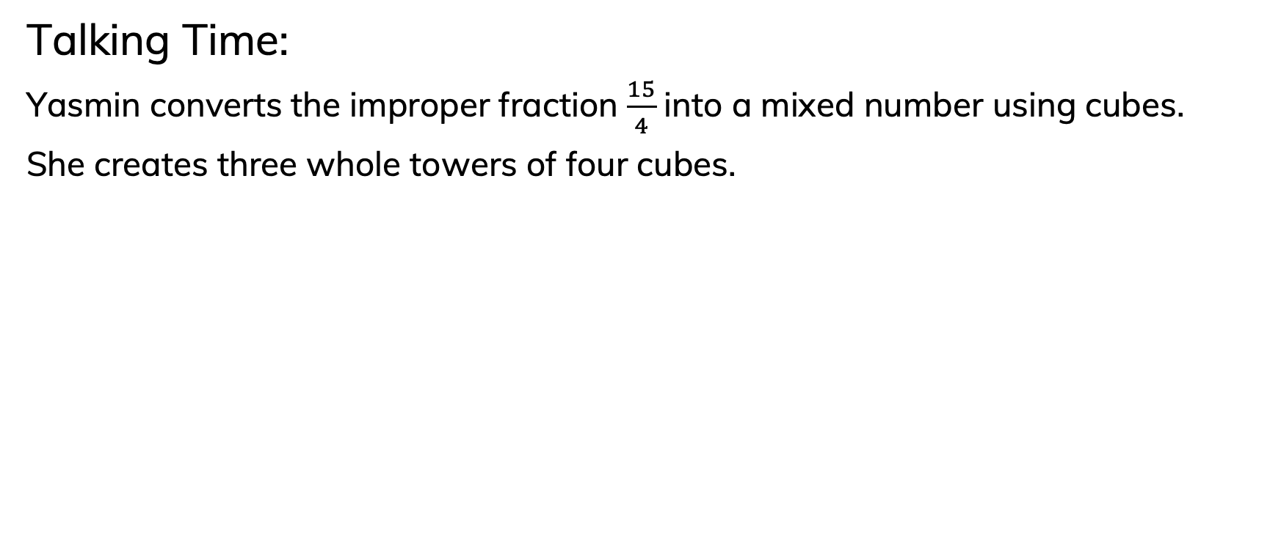
Talking Time:
Yasmin converts the improper fraction $\frac{15}{4}$ into a mixed number using cubes.
She creates three whole towers of four cubes.

Slide 15
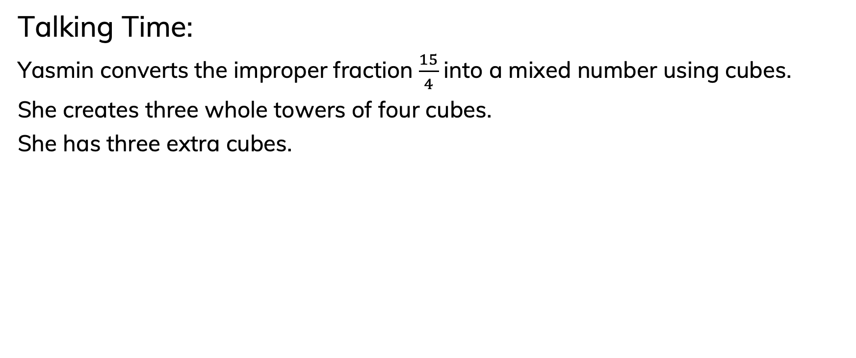


Talking Time:
Yasmin converts the improper fraction $\frac{15}{4}$ into a mixed number using cubes.
She creates three whole towers of four cubes.
She has three extra cubes.
is equal to 1
is equal to 3
is equal to 3 $\frac{3}{4}$

Slide 16
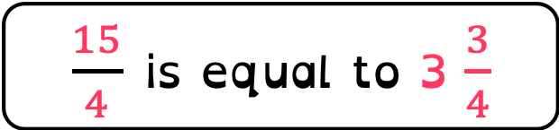
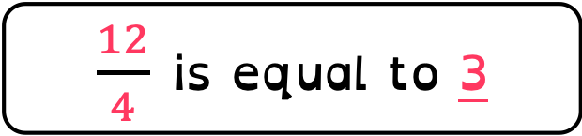
To be able to convert improper fractions to mixed numbers
Talking Time:
Yasmin converts the improper fraction $\frac{15}{4}$ into a mixed number using cubes.
She creates three whole towers of four cubes.
She has three extra cubes.
$\frac{4}{4}$ is equal to 1
$\frac{12}{4}$ is equal to 3
$\frac{15}{4}$ is equal to 3 $\frac{3}{4}$

Slide 17

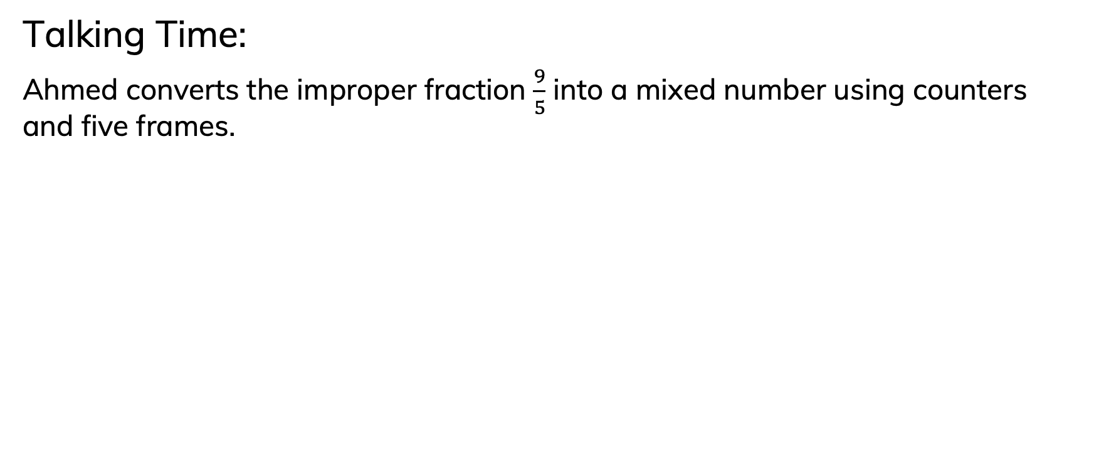
Talking Time:
Ahmed converts the improper fraction $\frac{9}{5}$ into a mixed number using counters and five frames.

Slide 18
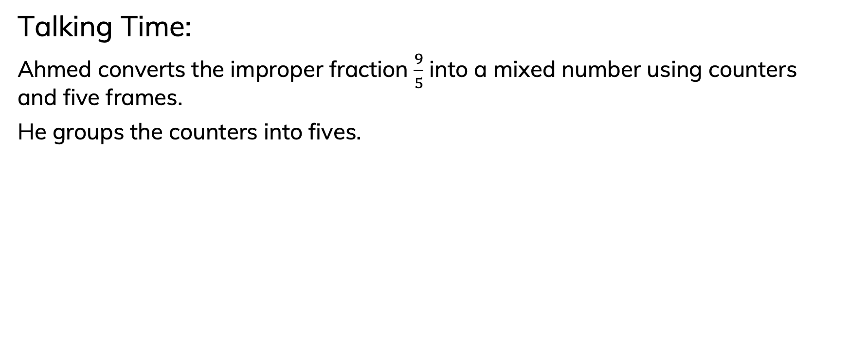
Talking Time:
Ahmed converts the improper fraction $\frac{9}{5}$ into a mixed number using counters and five frames.
He groups the counters into fives.

Slide 19
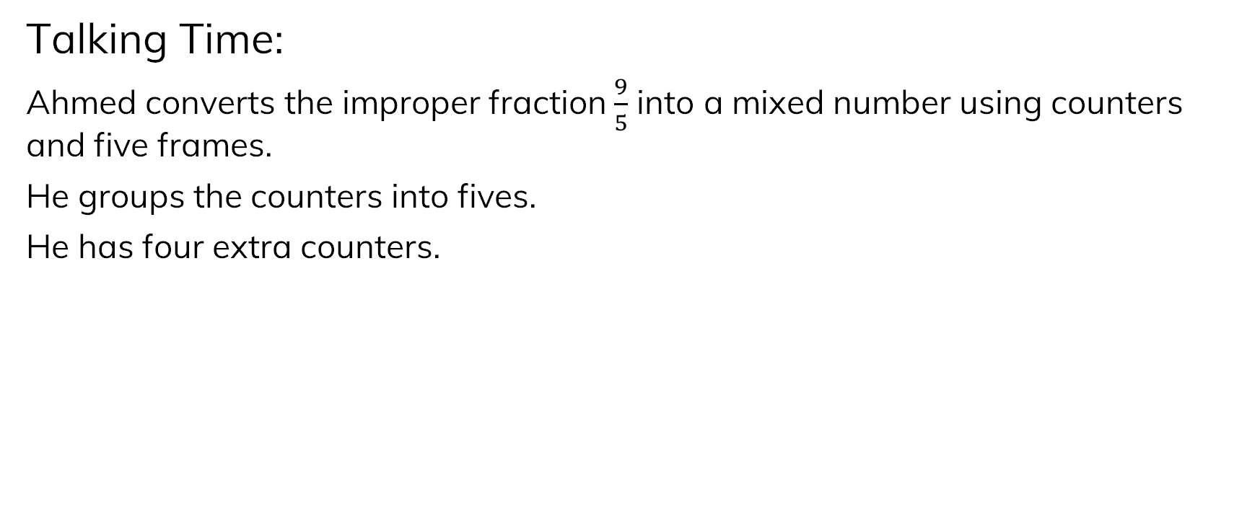
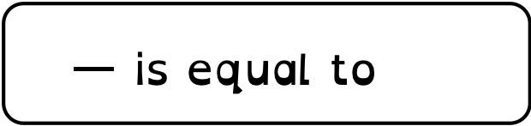
Talking Time:
Ahmed converts the improper fraction $\frac{9}{5}$ into a mixed number using counters and five frames.
He groups the counters into fives.
He has four extra counters.
is equal to 1
is equal to 1 $\frac{4}{5}$

Slide 20
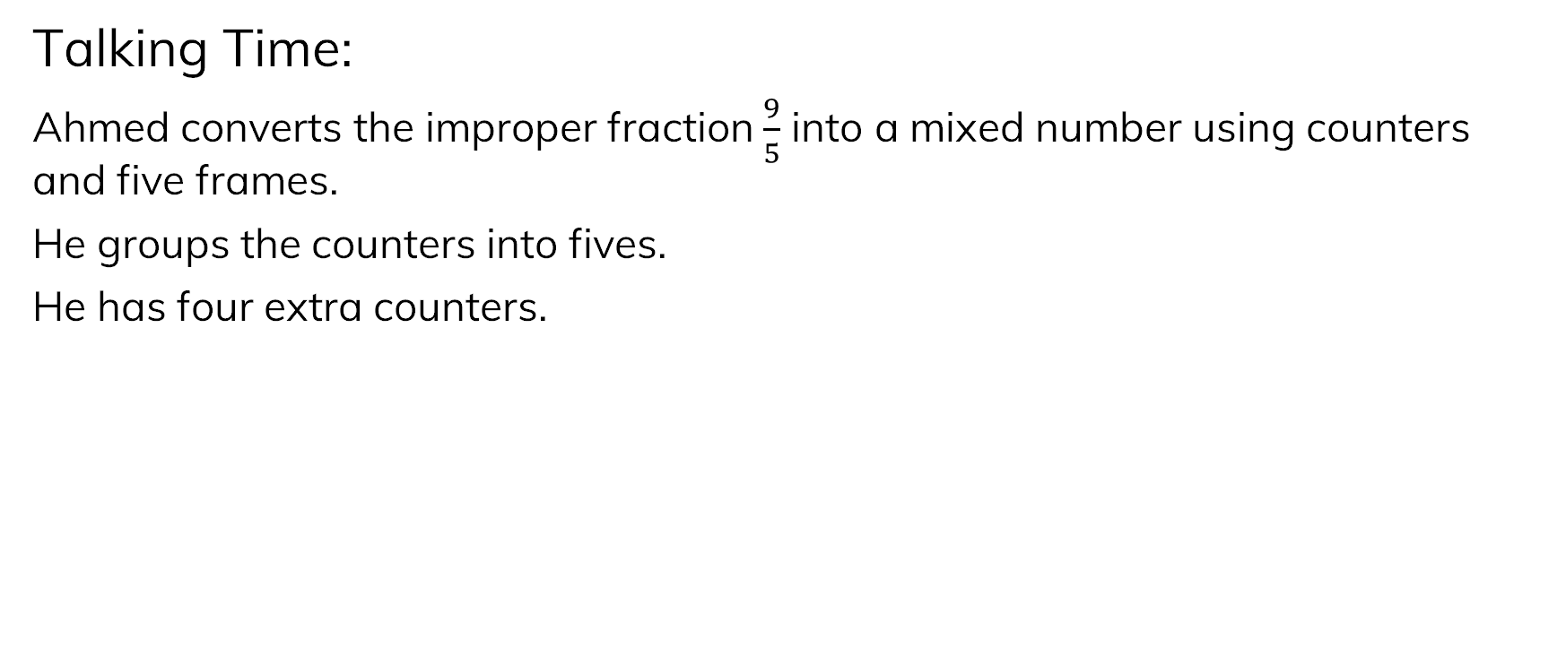
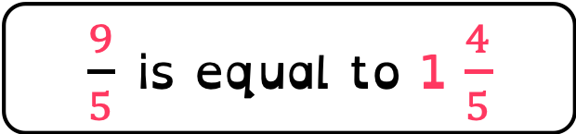
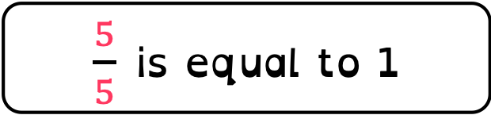
Talking Time:
Ahmed converts the improper fraction $\frac{9}{5}$ into a mixed number using counters and five frames.
He groups the counters into fives.
He has four extra counters.
$\frac{5}{5}$ is equal to 1
$\frac{9}{5}$ is equal to 1 $\frac{4}{5}$

Slide 21
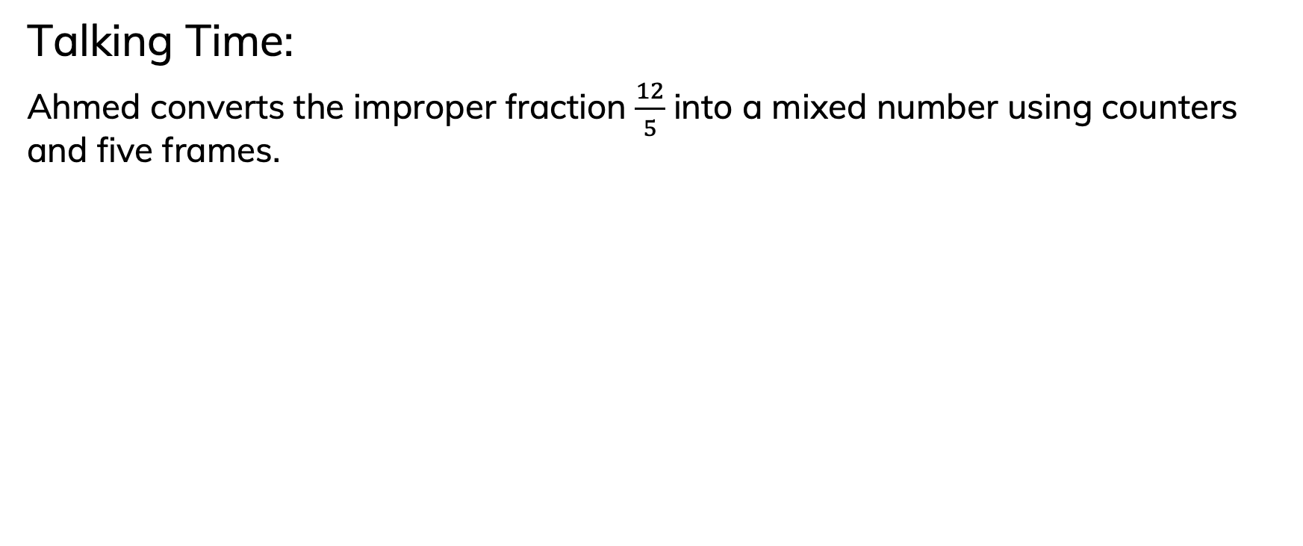
Talking Time:
Ahmed converts the improper fraction $\frac{12}{5}$ into a mixed number using counters and five frames.

Slide 22
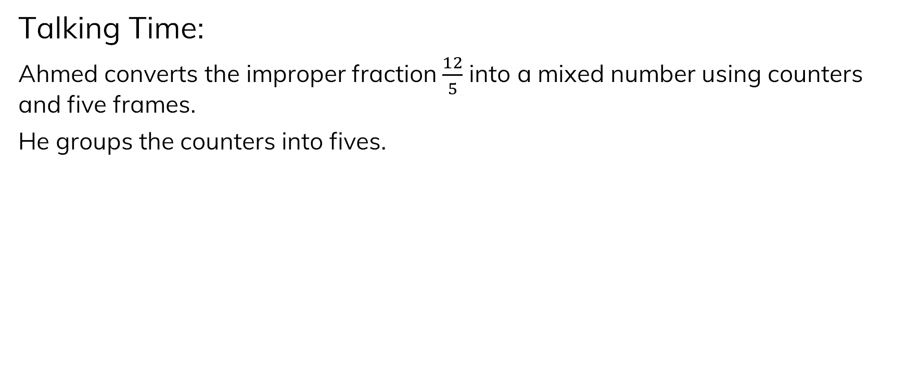
Talking Time:
Ahmed converts the improper fraction $\frac{12}{5}$ into a mixed number using counters and five frames.
He groups the counters into fives.

Slide 23

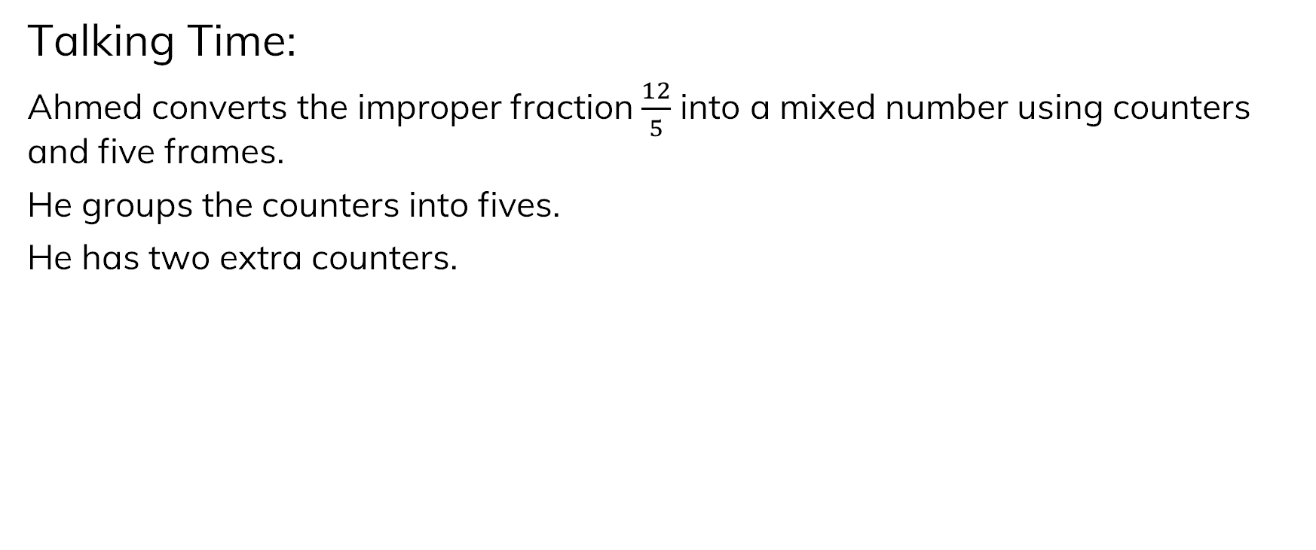
Talking Time:
Ahmed converts the improper fraction $\frac{12}{5}$ into a mixed number using counters and five frames.
He groups the counters into fives.
He has two extra counters.
is equal to 1
is equal to 2
is equal to 2 $\frac{2}{5}$

Slide 24
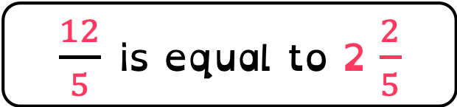
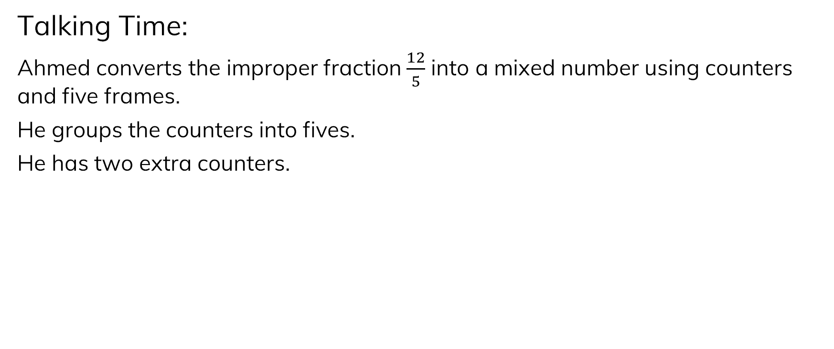
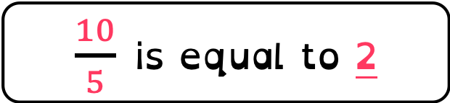
Talking Time:
Ahmed converts the improper fraction $\frac{12}{5}$ into a mixed number using counters and five frames.
He groups the counters into fives.
He has two extra counters.
$\frac{5}{5}$ is equal to 1
$\frac{10}{5}$ is equal to 2
$\frac{12}{5}$ is equal to 2 $\frac{2}{5}$

Slide 25
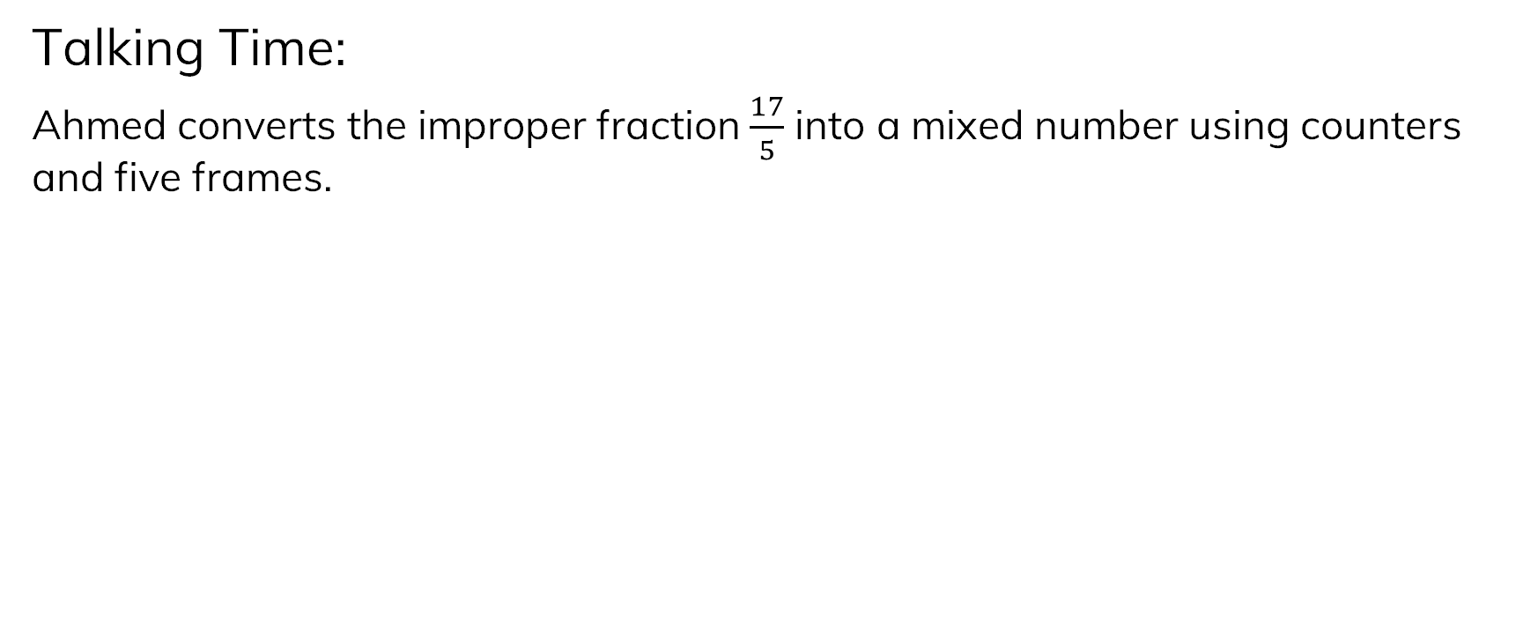
Talking Time:
Ahmed converts the improper fraction $\frac{17}{5}$ into a mixed number using counters and five frames.

Slide 26
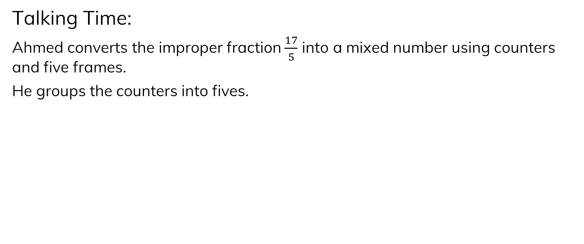
Talking Time:
Ahmed converts the improper fraction $\frac{17}{5}$ into a mixed number using counters and five frames.
He groups the counters into fives.

Slide 27
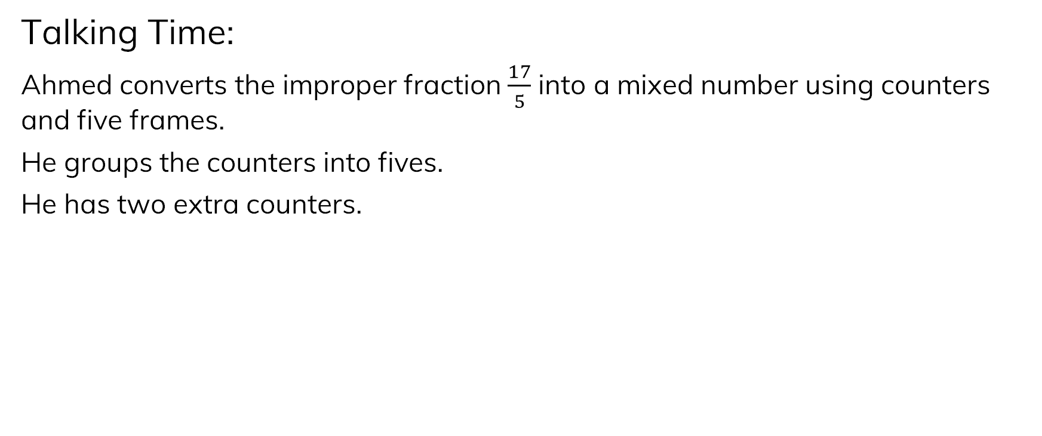

Talking Time:
Ahmed converts the improper fraction $\frac{17}{5}$ into a mixed number using counters and five frames.
He groups the counters into fives.
He has two extra counters.
is equal to 1
is equal to 3
is equal to 3 $\frac{2}{5}$

Slide 28
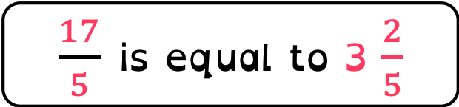
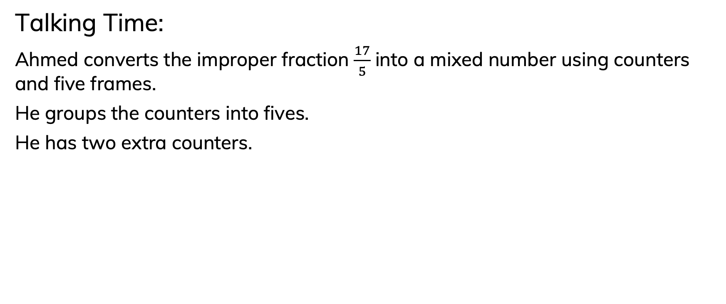
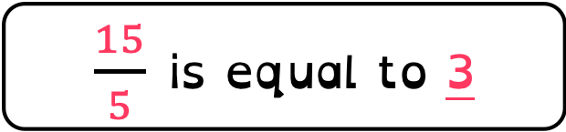
Talking Time:
Ahmed converts the improper fraction $\frac{17}{5}$ into a mixed number using counters and five frames.
He groups the counters into fives.
He has two extra counters.
$\frac{5}{5}$ is equal to 1
$\frac{15}{5}$ is equal to 3
$\frac{17}{5}$ is equal to 3 $\frac{2}{5}$

Slide 29
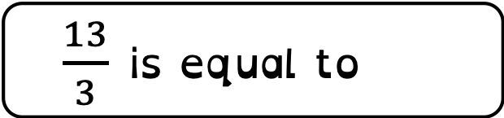
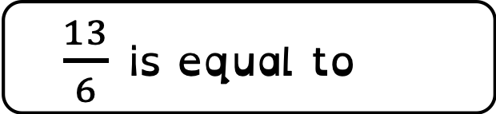

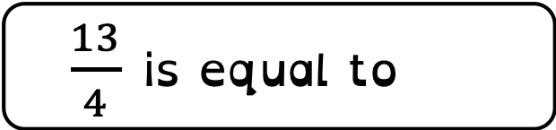
Draw models to help you complete the each of the questions below.
If you want to, you can cut up small pieces of paper to use as counters.
Remember, the denominator (the number at the bottom) tells us how many are in a whole one.
$\frac{13}{3}$ is equal to 4 $\frac{1}{3}$
$\frac{13}{4}$ is equal to 3 $\frac{1}{4}$
$\frac{13}{5}$ is equal to 2 $\frac{3}{5}$
$\frac{13}{6}$ is equal to 2 $\frac{1}{6}$

Slide 30
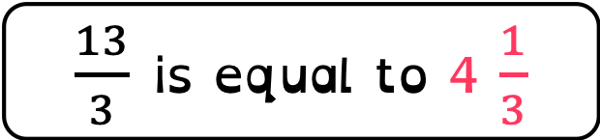
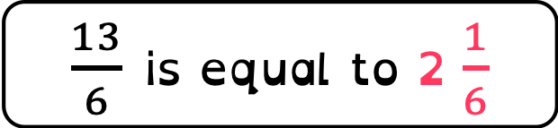
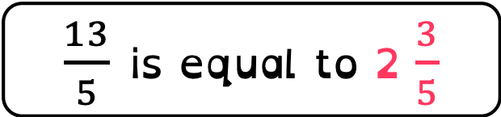
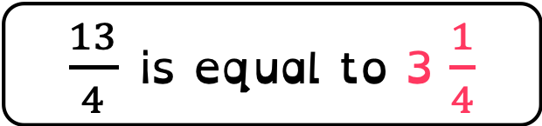
Answers:
If you didn't get each of these correct, take time to talk them through with an adult.
$\frac{13}{3}$ is equal to 4 $\frac{1}{3}$
$\frac{13}{4}$ is equal to 3 $\frac{1}{4}$
$\frac{13}{5}$ is equal to 2 $\frac{3}{5}$
$\frac{13}{6}$ is equal to 2 $\frac{1}{6}$

Slide 31
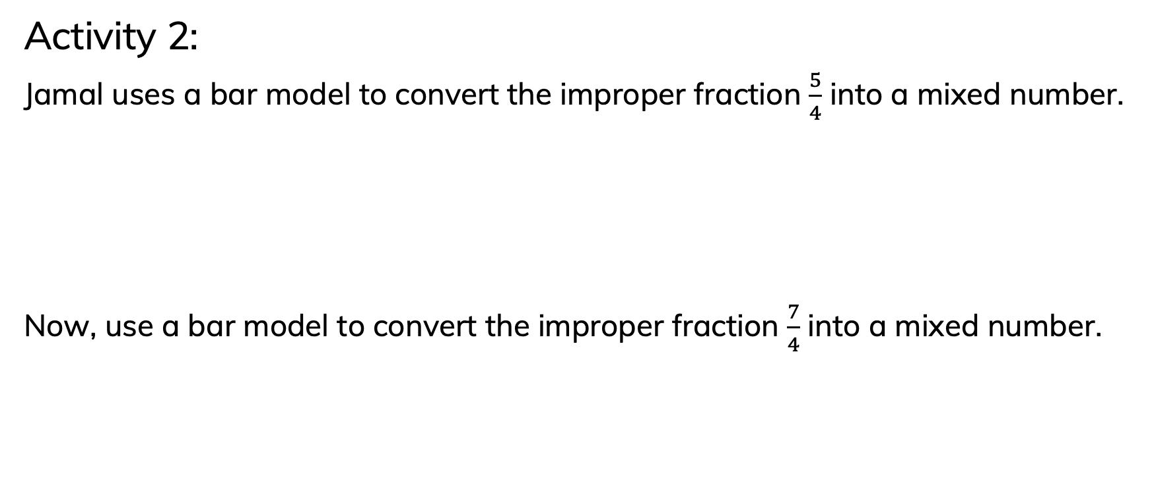
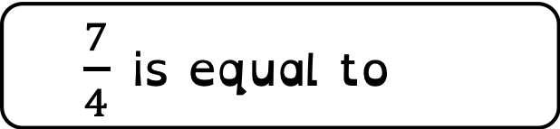
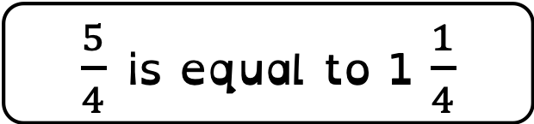
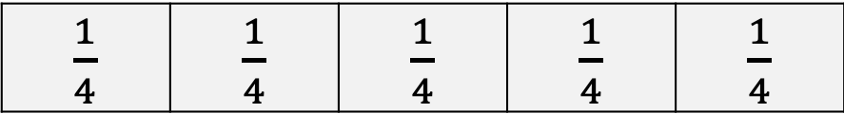
Activity 2:
Jamal uses a bar model to convert the improper fraction $\frac{5}{4}$ into a mixed number.
Now, use a bar model to convert the improper fraction $\frac{7}{4}$ into a mixed number.
$\frac{1}{4}$ | $\frac{1}{4}$ | $\frac{1}{4}$ | $\frac{1}{4}$ | $\frac{1}{4}$
$\frac{5}{4}$ is equal to 1 $\frac{1}{4}$
one whole
$\frac{1}{4}$ | $\frac{1}{4}$ | $\frac{1}{4}$ | $\frac{1}{4}$ | $\frac{1}{4}$ | $\frac{1}{4}$ | $\frac{1}{4}$
$\frac{7}{4}$ is equal to 1 $\frac{3}{4}$

Slide 32

Activity 2:
Jamal uses a bar model to convert the improper fraction $\frac{5}{4}$ into a mixed number.
Now, use a bar model to convert the improper fraction $\frac{7}{4}$ into a mixed number.
$\frac{1}{4}$ | $\frac{1}{4}$ | $\frac{1}{4}$ | $\frac{1}{4}$ | $\frac{1}{4}$
$\frac{5}{4}$ is equal to 1 $\frac{1}{4}$
one whole
$\frac{1}{4}$ | $\frac{1}{4}$ | $\frac{1}{4}$ | $\frac{1}{4}$ | $\frac{1}{4}$ | $\frac{1}{4}$ | $\frac{1}{4}$
$\frac{7}{4}$ is equal to 1 $\frac{3}{4}$
one whole

Slide 33


Talking Time:
Ruth uses bar models to convert the improper fraction $\frac{11}{4}$ into a mixed number.
$\frac{11}{4}$ is equal to 2 $\frac{3}{4}$

Slide 34


Answers:
two wholes
$$\frac{3}{4}$$
$\frac{11}{4}$ is equal to 2 $\frac{3}{4}$

Slide 35

Ruth has used a bar model to work out 17/6 as an improper fraction.
Have a go at solving this before you look at Ruth's answer.
Remember, if the denominator is 6, there will be six in a whole one.
$\frac{17}{6}$ is equal to 2 $\frac{5}{6}$

Slide 36


Answers:
two wholes
$$\frac{5}{6}$$
$\frac{17}{6}$ is equal to 2 $\frac{5}{6}$

Slide 37

Have a go at solving this one too.
Remember, if the denominator is 7, there will be 7 in a whole one.
$\frac{23}{7}$ is equal to 3 $\frac{2}{7}$

Slide 38


Answers:
three wholes
$$\frac{2}{7}$$
$\frac{23}{7}$ is equal to 3 $\frac{2}{7}$

Slide 39




Use your knowledge of division to solve each of the questions.
Click the link to hear me talk through one if you feel you need to.
https://www.loom.com/share/8a97f799d7da45c687e2d5a0be6e5194
$\frac{31}{4}$ is equal to 7 $\frac{3}{4}$
$\frac{31}{3}$ is equal to 10 $\frac{1}{3}$
$\frac{31}{9}$ is equal to 3 $\frac{4}{9}$
$\frac{31}{12}$ is equal to 2 $\frac{7}{12}$

Slide 40




Answers:
$\frac{31}{4}$ is equal to 7 $\frac{3}{4}$
$\frac{31}{3}$ is equal to 10 $\frac{1}{3}$
$\frac{31}{9}$ is equal to 3 $\frac{4}{9}$
$\frac{31}{12}$ is equal to 2 $\frac{7}{12}$

Slide 41




Spot the Mistakes.
You know the best way of doing this is to solve them on paper for yourself first.
Explain their mistakes in full sentences.
A
$\frac{23}{4}$ = 5 $\frac{1}{4}$
B
$\frac{17}{5}$ = 3
C
$\frac{23}{6}$ = 3$\frac{6}{5}$
D
$\frac{39}{10}$ = 30 $\frac{9}{10}$

Slide 42




Answers:
A has the correct whole number; however, the numerator is 3, not 1.
B has the correct whole number; however, there should be two fifths as the fraction within the mixed number.
C has the correct whole number, but the numerator and denominator have been written in the wrong order: five sixths should have been shown.
D has had the incorrect whole number – it should be 3 rather than 30.
A
$\frac{23}{4}$ = 5 $\frac{1}{4}$
B
$\frac{17}{5}$ = 3
C
$\frac{23}{6}$ = 3$\frac{6}{5}$
D
$\frac{39}{10}$ = 30 $\frac{9}{10}$

