Slide 1
Short Division
22nd February 2021
Miss Wood

Slide 2
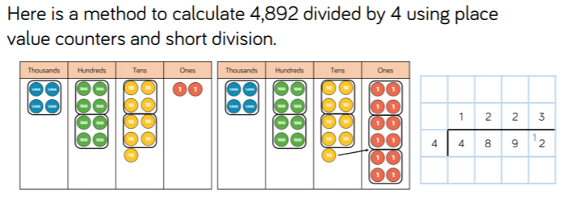
Click the link to hear an explanation of the pictorial and abstract method below.
https://www.loom.com/share/8bb8f372d0054f94b76ceedb298285f6

Slide 3
Let's have a go together.
You will need your pencil and paper ready so you can write this down with me.
Pause the video if you need to whilst you are drawing. Do not rush.
4496 / 4 =
https://www.loom.com/share/a1cf66606bee4333848a8731d09c2a37

Slide 4
Use the same method to solve these two problems. Only watch the link when you are finished.
6610 / 5 =
2472/3 =
https://www.loom.com/share/99b6a5ce4e6e41d199e30951aced711a

Slide 5

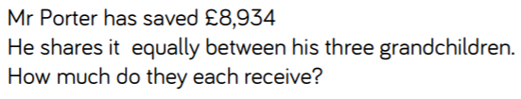
Try solving this problem independently.

Slide 6
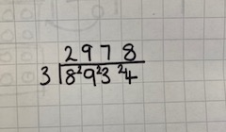
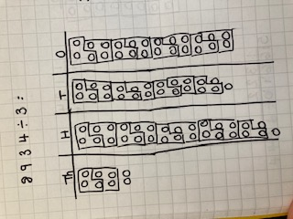
Wow, that needed a lot of exchanges!

Slide 7
It took me a long time to draw all the exchanges. Let's solve one using just the short multiplication method to see if it is more efficient.
https://www.loom.com/share/78215cabcbaf46628ba3c143f9eec65c

Slide 8
Have a go at solving these on your own.
Remember to ask yourself 'How many lots of____ in ____?'.
And 'Are there any left over I need to exchange?'.
9642/3 =
https://www.loom.com/share/a31c2edb92c540a0b4e1b8b7a67ba701
8460/4=
https://www.loom.com/share/c16c1d2593244c85a1eff4c83ae1a50f

Slide 9
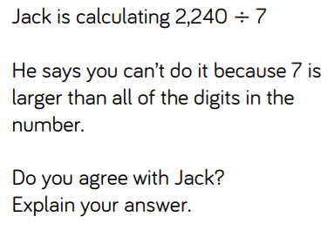
Have a go at explaining your thougths. Remember to write in full sentences.
https://www.loom.com/share/9a5cf6c1c9c94e81a6dc896cf6873eb2

