Slide 1
Short Division with Remainders
23rd February 2021
Miss Wood

Slide 2
Let's start by solving a calculation that uses the skills we learnt yesterday.
9675/3 =
https://www.loom.com/share/4aa50a1b1bc748e3b7eef52d2a5f45a3

Slide 3
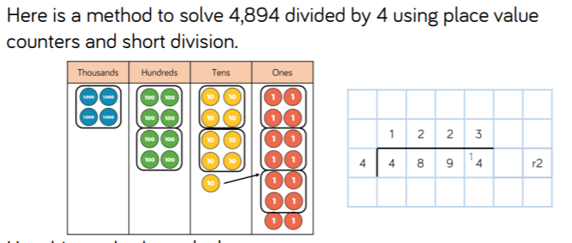
Click the link to hear my 'think aloud'.
https://www.loom.com/share/094118d8883e496a8337839d02cf60c0

Slide 4
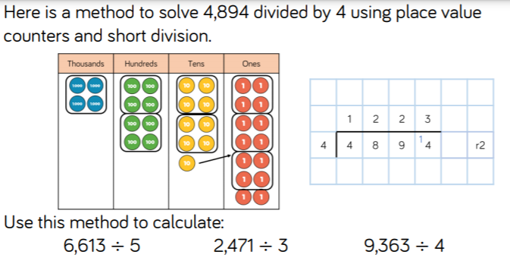
Use short division to solve the three calculations at the bottom.

Slide 5
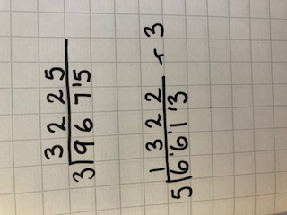
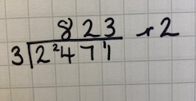
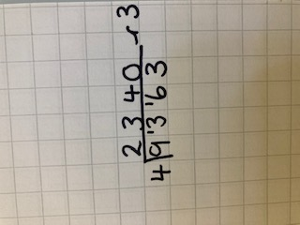
Answers

Slide 6
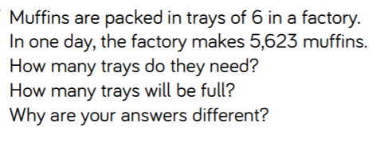
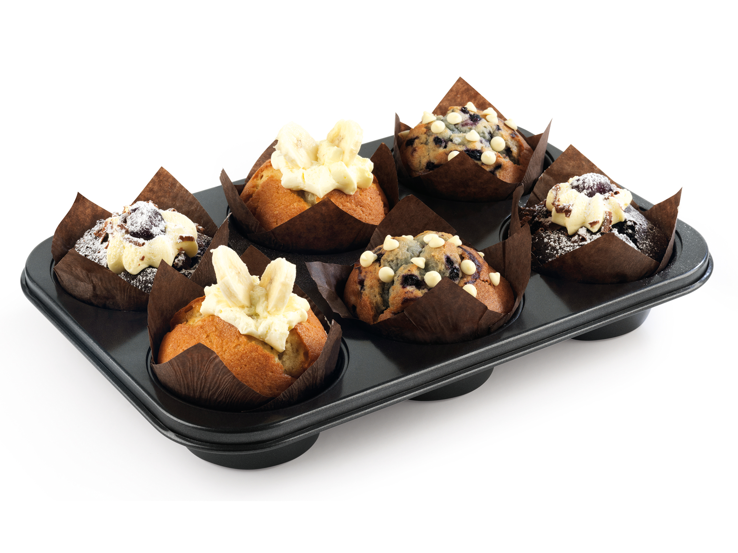
Try solving this independently.
Expain why your answers are different in full sentences.

Slide 7

Check your answers on the link below.
https://www.loom.com/share/f740f5a5aa634c2e90206d50e21dfda3
Remembe to make any corrections that are needed and annotate
your working out.

Slide 8
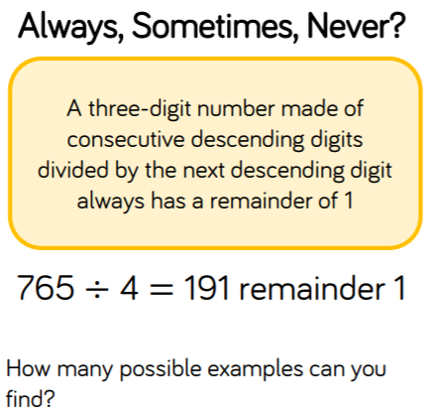
Consecutive means numbers that come one after the other.
Descending means numbers that are getting smaller.
So consecutive, descending numbers could be 321.

